Slide 1
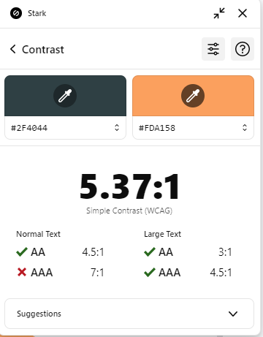
OSC
Science & Tech
MVC session 3
Zanaty & Mahmoud

Slide 2
Table of contents
01
02
03
04
05
06
Partial Views
Routes
Repository Pattern
Dependency Inversion
Filters
Authorization

Slide 3
01
Partial View

Slide 4
What?
Partial View is a view can be part of another views 🙂
it is a View without Layout.

Slide 5
Why?
Long Page
Don’t Repeat Yourself
Having a long Markup and want to edit in part of it.
Break down the page into small partial views,
Usually you may find parts of views
Repeated in other views.
Use Partial view to insert it directly in the view without copy & paste in other views

Slide 6
How?
Add View
01
02
Razor View
Create new view in View folder.
Choose Razor and choose “create as a partial view” option.
Hit add
04
03
Name
Congratulation, You have now a Partial View
Pest Practise to start the name of the partial view with “_”

Slide 7
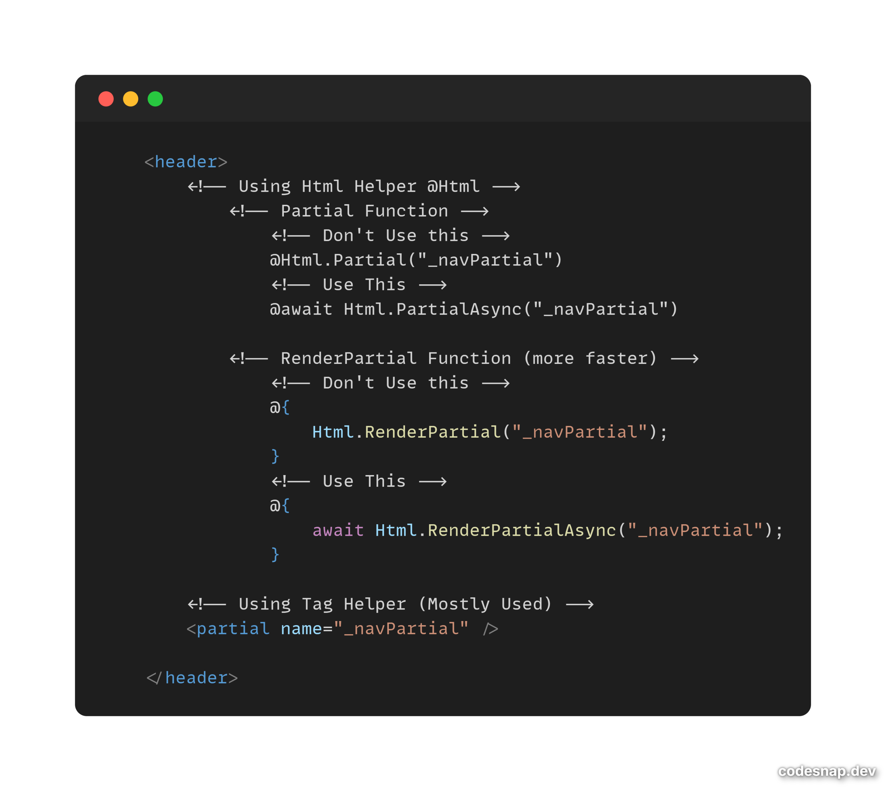
How to add in other Views

Slide 9
How to add in other Views

Slide 10
Calling action as a Partial View?
Why could we call action as partial views instead of Regular views
We want the action to return HTML only (not a whole page)
Make partial request and response instead of full request or response
How…?

Slide 11
Ajax

Slide 12
What is Ajax?
Asynchronous JavaScript And XML
Used to make HTTP requests without reloading the whole page.

Slide 13
Why Ajax?
Speed
Universal
Update small pieces of UI without a full-page refresh.
Works with many server endpoints like MVC actions and Web API.

Slide 14
02
Routes

Slide 15
How URLs are mapped
Only one?
Base Url
Action
Controller
Id

Slide 16
Routes?
Routes define how paths are mapped to controller actions (and optionally to parameters “id?”)
It takes URL like ( products/details/5 )
Decides which controller, which action and what paramater to invoke.

Slide 17
03
Repository Pattern

Slide 18
Here are three important issues
Controllers become tightly coupled to all services
Difficult to test
Code isn’t available for expansion the logic

Slide 19
SOLID Principles?
Single Responsibility
Liskov Substitution
Dependency Inversion
Open/Closed
Interface Segregation

Slide 20
Repository Pattern
Separates data access logic from business logic.
Makes it easier to switch data sources and test without touching controllers.

Slide 21
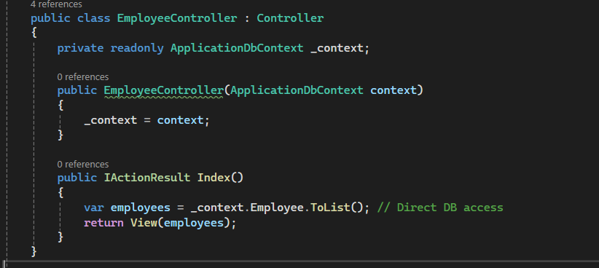
Before:

Slide 22
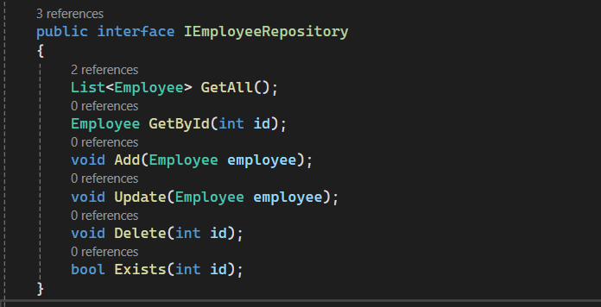
Step 1: Create Interface for CRUD op

Slide 23
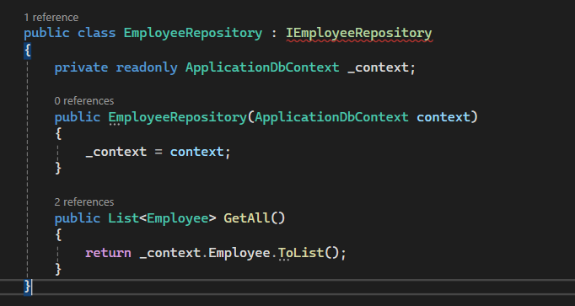
Step 2 : Implement the Interface

Slide 24
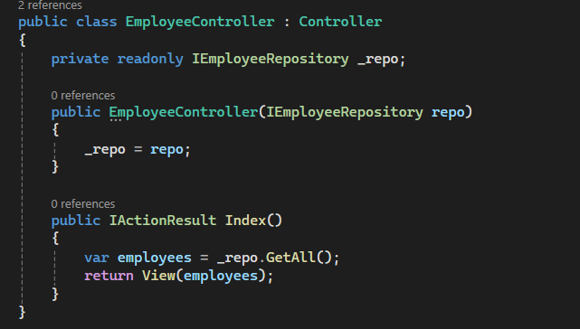
Step 3 : Pass it as a parameter

Slide 25
Final Result:
Repository Pattern
Controller is clean and not tied to EF or DB.
Easy to replace data source with API, file, or mock data.

Slide 26
04
Dependency Inversion principle (DIP)

Slide 27
Dependency Inversion
Why to Use DIP:
High-level modules (controllers) should depend on abstractions (interfaces), not concrete implementations.
DIP prevents high-level logic from being tied to low-level details.

Slide 28
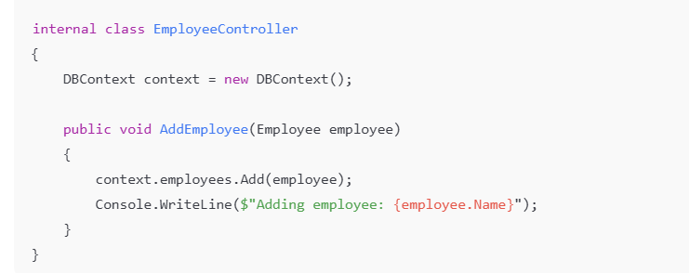
Before:

Slide 29
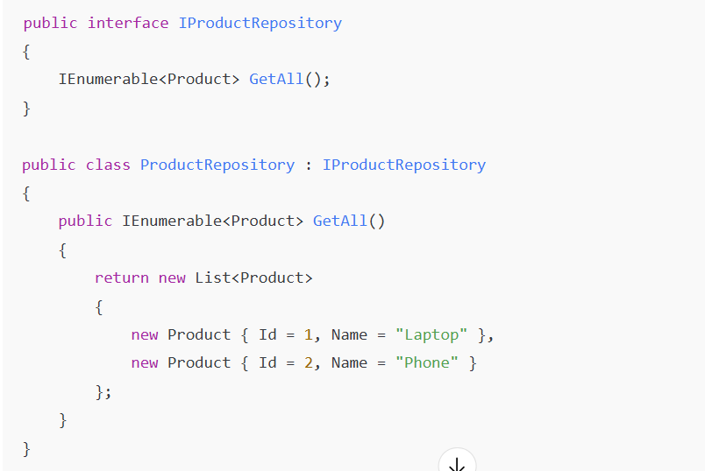
After:

Slide 30
Final Result:
Dependency Inversion
High-level code (controller) can use any repository implementation
Adding new data behaviors doesn’t require changes to controller code.

Slide 31
Inversion of Control (IoC)

Slide 32
Inversion of Control
Why to Use IoC:
Let a container/framework create and wire objects instead of manual new calls.
DIP prevents high-level logic from being tied to low-level details.

Slide 33
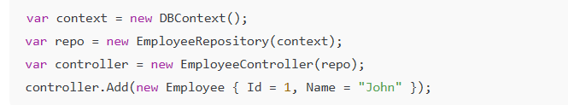
Before:

Slide 34
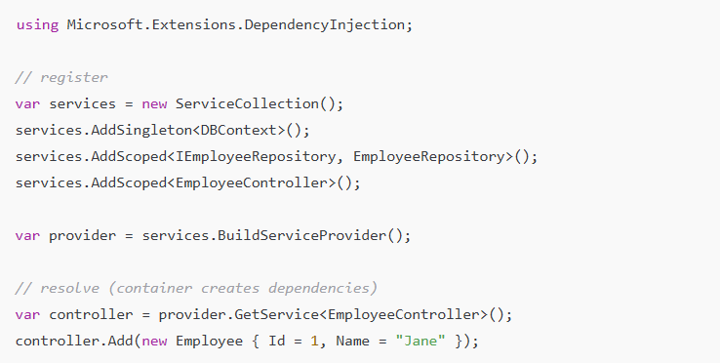
After:

Slide 35
Inversion of Control
Results:
Centralized wiring, easier swaps & testing.
No manual “new” calls — easier to swap implementations and write unit tests.

Slide 36
Dependency Injection (DI)

Slide 37
Dependency Injection:
Inject dependencies instead of creating them inside controllers. Keeps code flexible and testable.

Slide 38
05
Filters

Slide 39
Filters in MVC
Filters let you run code at MVC pipeline points (pre/post action, exceptions, etc.) to centralize cross-cutting concerns.
Before (problem) — duplicated logging in actions:
During (problem) → Validating input in every action method
After (problem) → Running cleanup code after an action executes

Slide 40
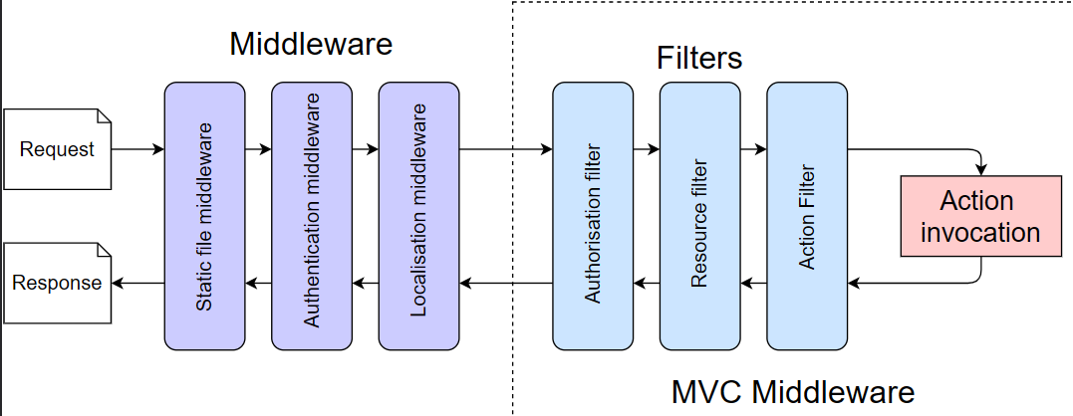
Filters in MVC

Slide 41
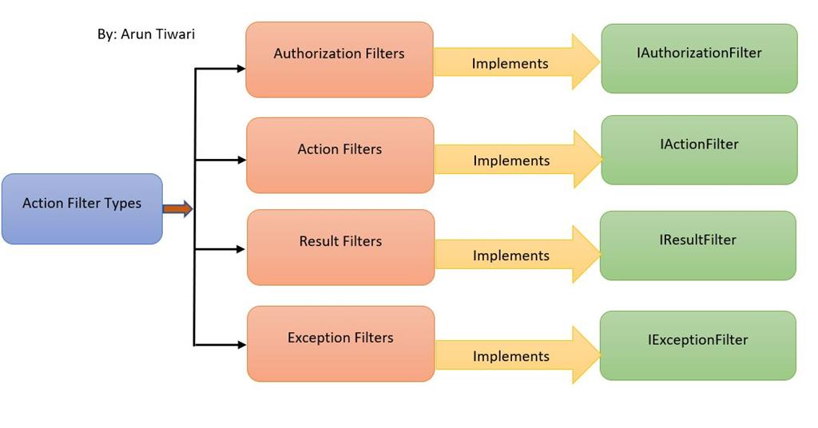
Filters and implementations

Slide 42
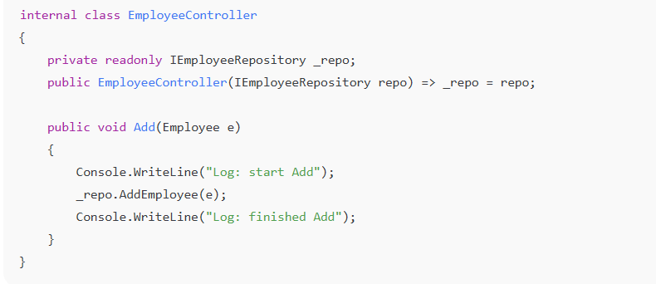
Before: duplicated logging in actions

Slide 43
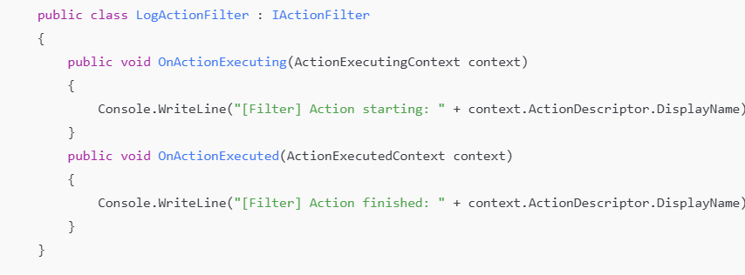
After: use an IActionFilter:

Slide 44
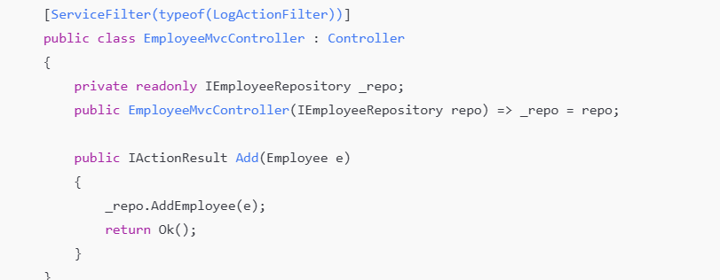
Step 2: using the Filter

Slide 45
06
Authorization

Slide 46
Authorization
Authorization decides whether an authenticated user can perform an action or not . Uses attributes not manual Checks
Popular Roles:
Admin → Full access to manage users, data, and settings.
Viewer/User → Can only view content, no editing rights.
Guest → Limited or temporary access, often read-only.

Slide 47
Identity
ASP.NET Core Identity, which is Microsoft’s built-in authentication and authorization system for web apps and APIs, you need to install NuGet package: Microsoft.AspNetCore.Identity.EntityFrameworkCore .
Think of it as a ready-made membership system that handles all the boring but critical parts of user accounts, like:
Authentication → Checking if a user is who they claim to be (login).
Authorization → Deciding what that user can do (roles, policies, claims).
User management → Creating, updating, deleting accounts.
Password hashing → Storing passwords securely.
External logins → Google, Facebook, Microsoft, etc.

Slide 48
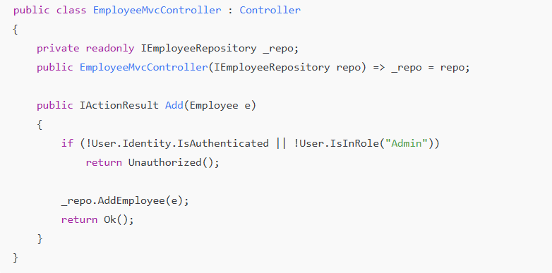
Before: Manually Checking

Slide 49
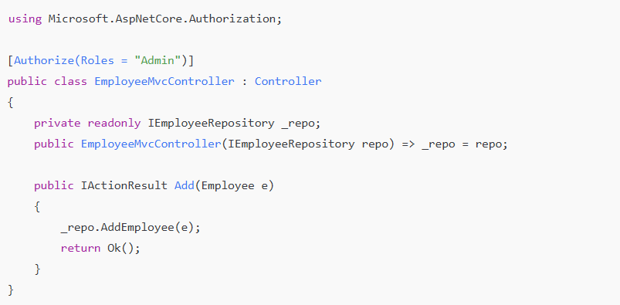
After: Using Attributes

Slide 50
Thanks!

